Slide 1
Polycystic ovary syndrome (PCOS) Classification
Team LIFT
Data Science Final Project

Slide 2
Polycystic Ovary Syndrome (PCOS)
PCOS is a hormonal disorder common among women of reproductive age.
Women with PCOS may have infrequent or prolonged menstrual periods or excess male hormone (androgen) levels.
The ovaries may develop numerous small collections of fluid (follicles) and fail to regularly release eggs.

Slide 3
Knowing our Dataset
The dataset contains total 45 columns
Out of 45 columns, 19 columns has float data type
23 columns have integer data type and 3 columns have object data type.
Target column has 2 outputs; 0 and 1.
1 for PCOS positive and 0 for PCOS negative.

Slide 4


Data Wrangling
Input data is not in a desired format so we applied data wrangling to make it useable for analysis.
Converting Patient File No columns into 64 bit integer.
Converted AMH(ng/mL) and beta-HCG(mIU/mL) into numeric type
trimming column names where there are extra spaces at start and end
Dropping not useful columns

Slide 5
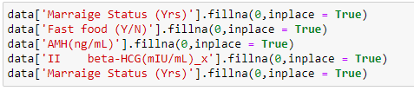
Data Wrangling
1. Merging both datasets
2. Replacing missing data with zero.

Slide 6
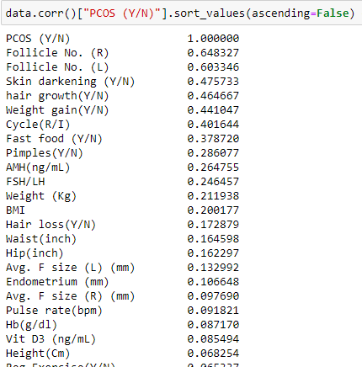
Exploratory Data Analysis (EDA)
1. Displaying columns that are correlated with PCOS
2. Follicle No.(R)
3. Follicle No. (L)
4. Skin Darkening
5. Hair Growth
6. Weight Gain
Cycle (R/I) are highly correlated with PCOS

Slide 7
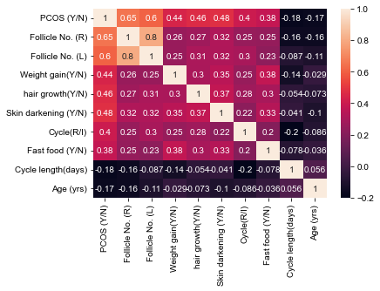
Exploratory Data Analysis (EDA)
Visualizing the Heatmap of Correlated features

Slide 8
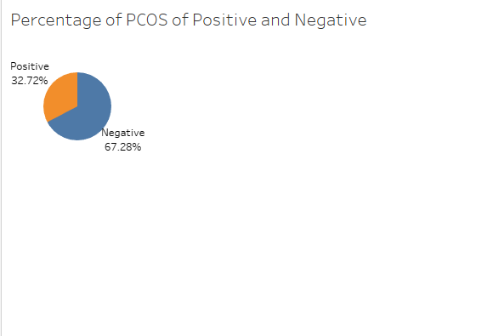
Exploratory Data Analysis (EDA)
In our dataset, 32.72% are PCOS positive
The rest of the 67.28% are PCOS negative

Slide 9
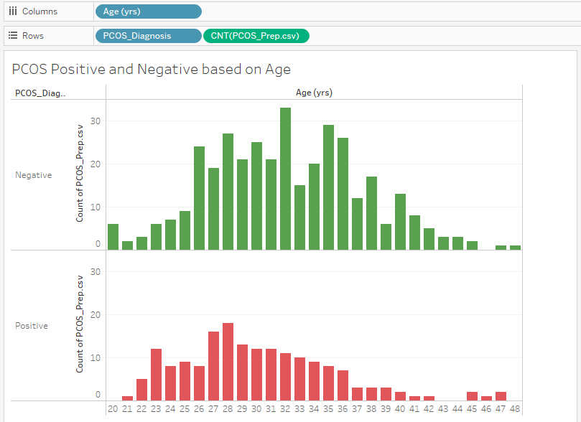
Exploratory Data Analysis (EDA)
Visualizing the Age trend with PCOS positive and PCOS negative

Slide 10
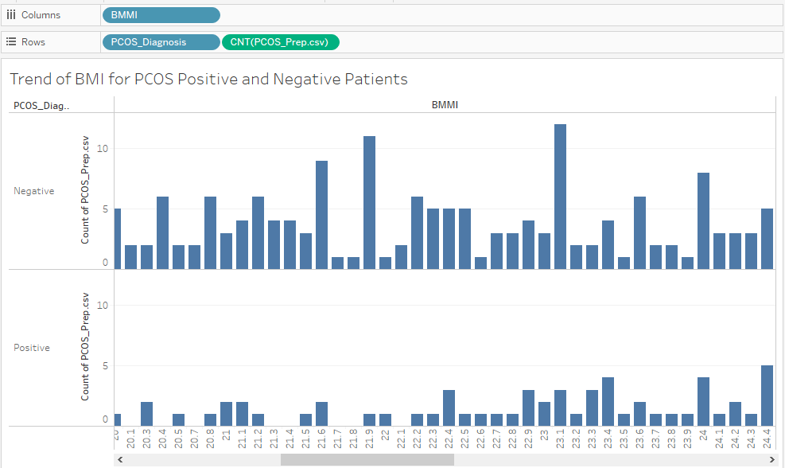
Exploratory Data Analysis (EDA)
Visualizing the trend of BMI with PCOS

Slide 11
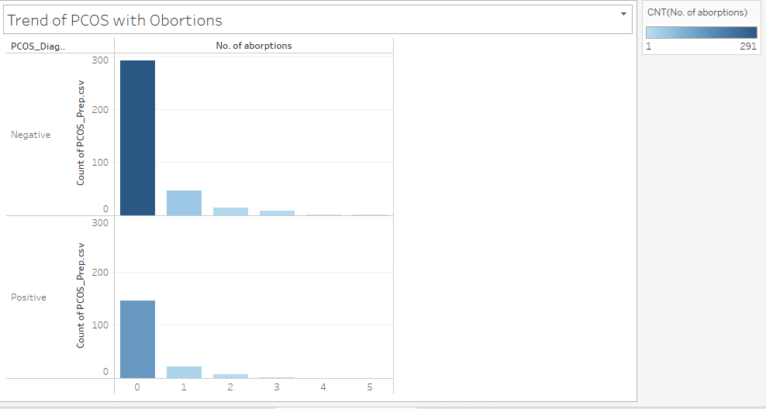
Exploratory Data Analysis (EDA)
Visualizing the trend of Number of abortions with PCOS

Slide 12
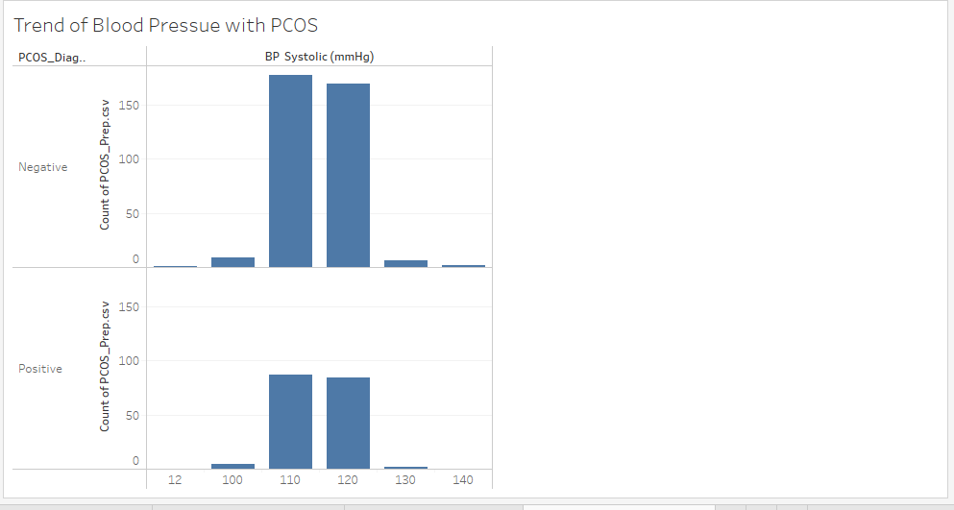
Exploratory Data Analysis (EDA)
Visualizing the trend of BP systolic (mmHg) with PCOS

Slide 13
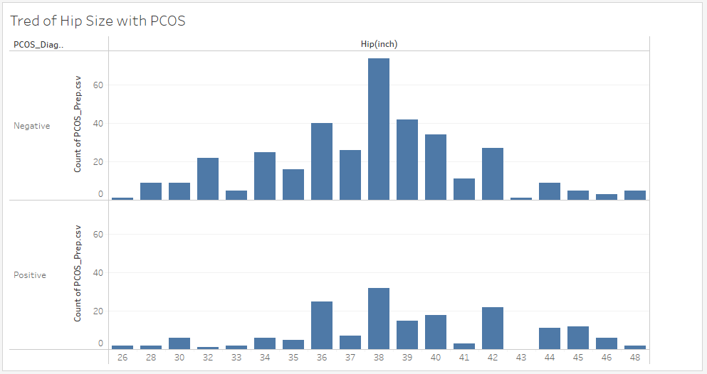
Exploratory Data Analysis (EDA)
Visualizing the trend of Hip(inch) with PCOS

Slide 14
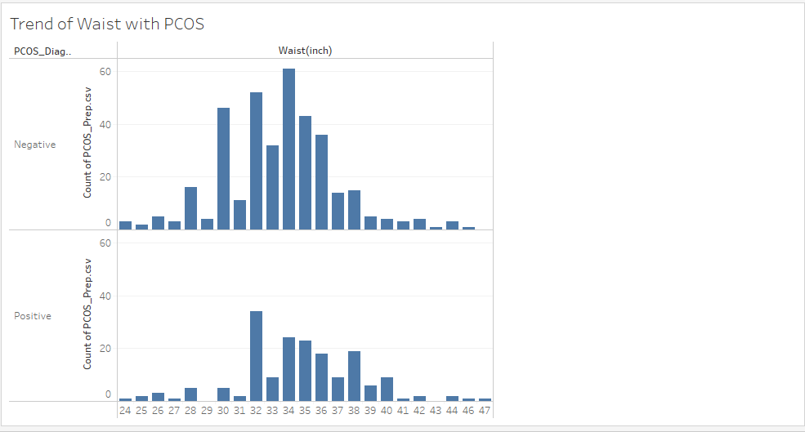
Exploratory Data Analysis (EDA)
Visualizing the trend of Waist(inch) with PCOS

Slide 15
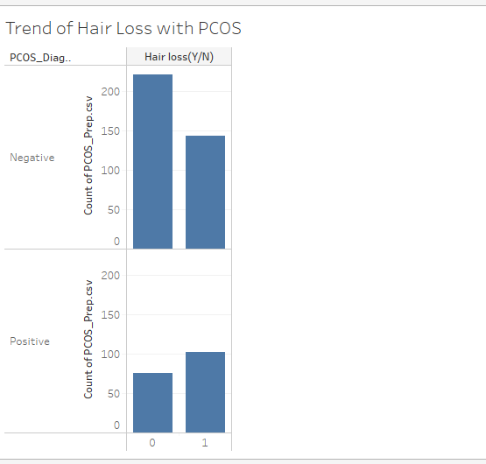
Exploratory Data Analysis (EDA)
Visualizing the trend of Hair loss (Y/N) with PCOS

Slide 16
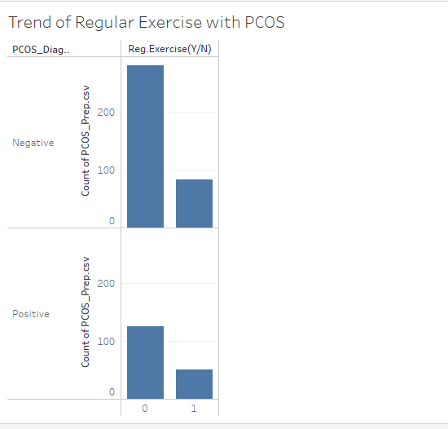
Exploratory Data Analysis (EDA)
Visualizing the trend of Reg Exercise (Y/N) with PCOS

Slide 17
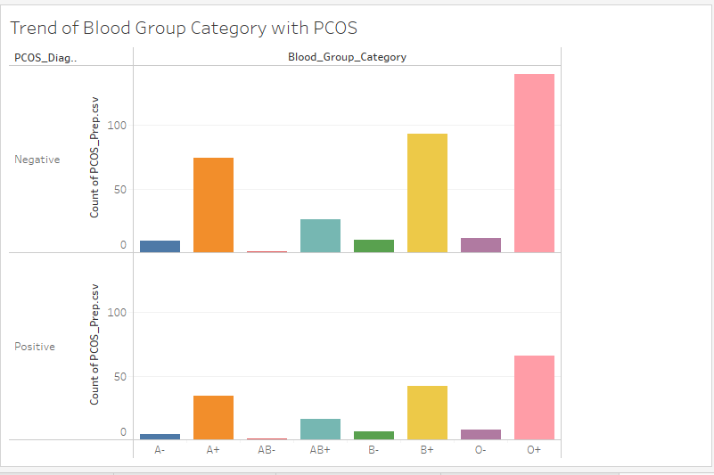
Exploratory Data Analysis (EDA)
Visualizing the trend of Blood Group Category with PCOS

Slide 18
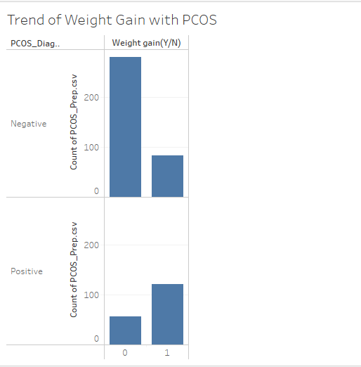
Exploratory Data Analysis (EDA)
Visualizing the trend of Weight Gain (Y/N) with PCOS

Slide 19
Statistical Testing
After performing Data Analysis we observed the symptoms of PCOS disease. In Statistical Testing we are going to test a few symptoms, are these symptoms statistically important to cause PCOS
Applying Chi-Square Test on
Hair Growth
Weight Gain Columns

Slide 20
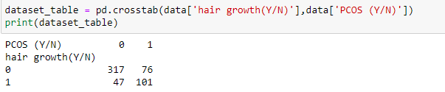
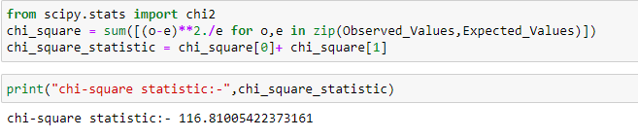
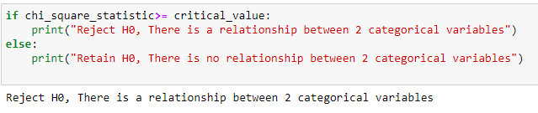
Statistical Testing
1. Creating contingency table
2. Calculating Chi-square value
3. Calculating the relationship of two columns

Slide 21
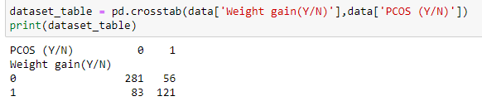
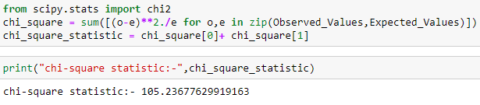
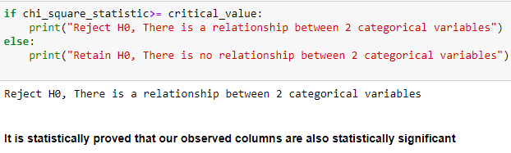
Statistical Testing
Applying Chi-Square test on Weight Gain
1. Creating a contingency table
2. Calculating the Chi-Square value

Slide 22
Applying Machine Learning
We were able to identify which columns are useful in the prediction of PCOS so we are going to train a machine learning model with those features and calculate the accuracy of our trained model.
We are going to apply two Machine Learning algorithms:
Logistic Regression
Random Forest Classifier

Slide 23
Logistic Regression
Logistic regression aims to solve classification problems. It does this by predicting categorical outcomes, unlike linear regression that predicts a continuous outcome. In the simplest case there are two outcomes, which is called binomial, an example of which is predicting if a tumor is malignant or benign.

Slide 24

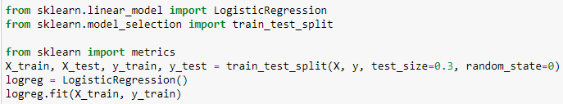
Logistic Regression
1. Separating the dependent and independent variables
2. Fitting training data to the Logistic Regression model

Slide 25
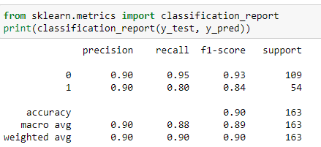
Logistic Regression
1. Calculating the accuracy of Logistic Regression
2. Displaying the Classification report of Logistic Regression

Slide 26
Random Forest Classifier
A random forest is a machine learning technique that’s used to solve regression and classification problems. It utilizes ensemble learning, which is a technique that combines many classifiers to provide solutions to complex problems.

Slide 27
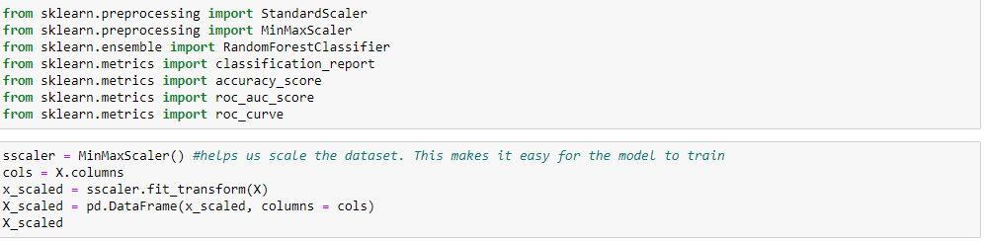
Random Forest Classifier
Applying MinMax scaler

Slide 28
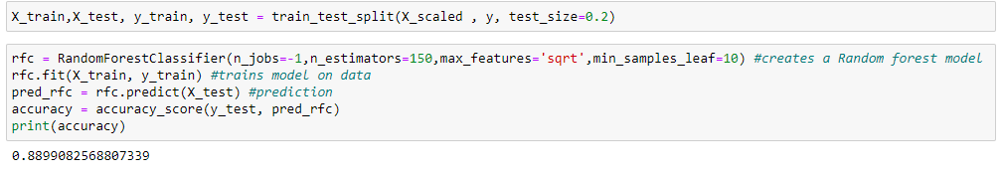
Random Forest Classifier
Passing training dataset to Random Forest Classifier model for training and after training calculating the accuracy of the model

Slide 29
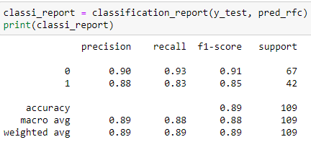
Random Forest Classifier
Displaying the Classification report of Random Forest Classifier

Slide 30
Conclusion
Algorithm | Accuracy
Logistic Regression | 90%
Random Forest Classifier | 88%
The accuracy of Logistic Regression is 2% higher from Random Forest Classifier. This means Logistic Regression is performing better than Random Forest Classifier.

